Slide 1


RBC Proof of Concept
The Proof of Concept exercise was conducted in Feb/Mar 2020 with Royal Bank of Canada Transfer Agency Operations in Dublin
A series of interactive workshops was held over 8 weeks with a dedicated FAC network environment to engage with, understand and validate the ‘TA2.0’ model
There was active participation from RBC Product and Operational SMEs
Based on the ‘day in the life of a fund’ (DITLOAF), we walked through the principal activities of a TA for investor take on, order management, pricing and settlement and income distribution (see following slide)
Existing TA activates mapped to FAC and key areas of impact identified and documented (see following slide)
Follow-up analysis of benefits and the proposed commercial model has fed into RBC’s internal business case for further engagement with FAC
RBC concluded that FAC implementation could deliver a significant reduction in their TA operational costs

Slide 2
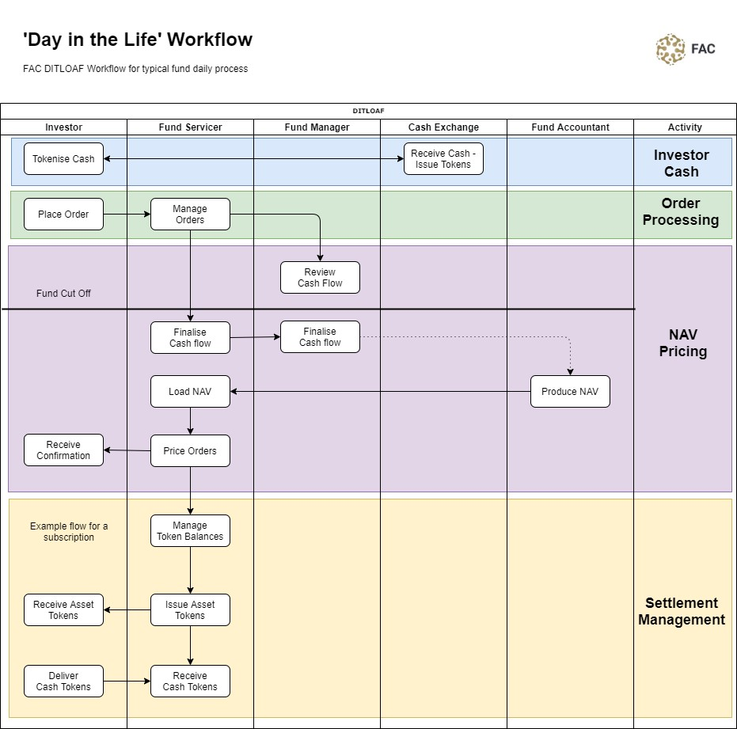
Day in the life of a fund
PoC, like the upcoming pilot, was focused on a ‘Day in the Life of a Fund’ process.
The workflow is very similar to a conventional fund flow, but there are significant differences:
Common messaging platform and data transparency The FAC network eliminates the multiverse of disparate and loosely coupled systems operated by individual companies. Data is seamlessly available to all participants on a real time basis.
Reduction in reconciliation – Participants share a common data set on a ‘I see what you see’ basis, so the need to reconcile data between systems and resolve errors is eliminated.
Simplified settlement through tokenisation of cash and assets – Tokenisation allows the funds settlement process, the exchange of cash and assets, to be decoupled from the banking settlement processes; this significantly reduces settlement time, delivers immediate finality and reduces risk.

